Slide 1


BUSINESS PROCESS MAPPING
A method that promotes a better understanding of processes and helps organizations identify areas for improvement.
As-Is Process Validation Workshop Pos Logistics Berhad
29th – 31st January 2026
Enhancing your organization’s potential
© 2026 Jasmiza Solutions Sdn Bhd. All Rights Reserved. No part of this content may be reproduced in part or in whole, stored in a retrieval system or transmitted in any form or by any means (electronic, mechanical, photocopying, recording or otherwise) without the written permission of the copyright owner.

Slide 2
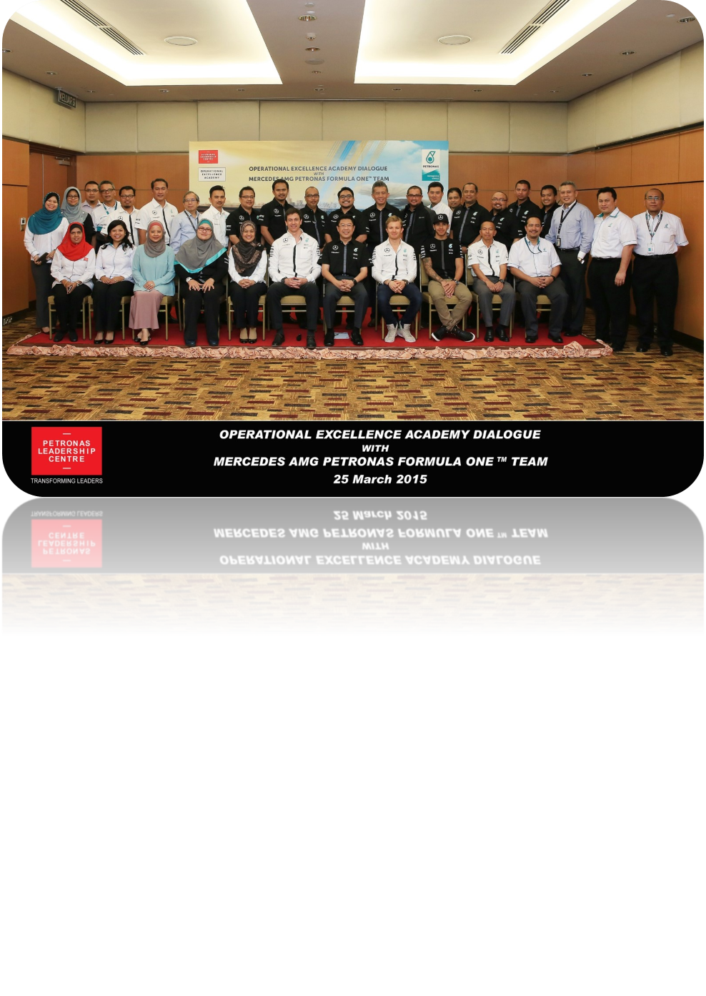
JSSB Approach for Business Process Mapping
Our BPM methodology has been implemented for more than 20 years across over 300 companies. This includes extensive training delivered to DRB-Hicom subsidiaries through more than 60 sessions nationwide.
Business Process Mapping is a long term fast result change program adopted by organizations who aims to:
• Empower line managers to take charge on their own resources (5M) to deliver desired outcomes
• Optimize current resources to deliver desired outcomes when there are changes in the business strategy (3R: reskill, replace or remove)
• Replicate and repeat business units for upsizing and branching
The bottom line is to provide answer to these key questions:
1. Who should deliver what
2. How many are needed to deliver the desired output
3. Optimization is not reductions!

Slide 3

BPM is the first step for Enterprise Automation
5 Steps in Enterprise Automation
Stock Take As-Is
Work Design
Process Optimization
Process Digitization
Intelligent Automation
Key Objective
Key Result Indicators (KRI)
Value Chain
Org Chart
SIPOC
ICOR
Deployment Chart
Eliminate non-value added activities
Standardize workflows
Reduce cycle time
Minimize errors
Define digital requirements
Build digital workflows/interfaces
Integrate data sources
Robot Process Automation
Workflow engines/BPM system
AI/ML for cognitive task
API for system-to-system automation
Where we are now..
The expected outcomes from BPM is 5Ms elements will be optimized
Machine*
*Method and machine optimization will be the primary focus during the automation phase of Pos Logistics’ digital transformation journey.
Money
Manpower
Method*
Material

Slide 4

5 Levels of Document Hierarchy
Business process mapping is conducted from Level 2 (SIPOC) through Level 4 (Deployment Chart), progressively increasing the level of detail to clearly define, analyse, and standardise organizational processes.
Policy
Communicate organization’s culture, values, and philosophy.
Cover expectation of employers from the employees and vice versa.
L1
L2
L3
L4
L5
SIPOC
A comprehensive overview of a process, its key components, and the stakeholders involved.
Supplier, Input, Process, Output, Customer.
ICOR
More detailed continuation of SIPOC, deeper and more understandable sub-processes
Input, Control, Output, Resources
Business Process Mapping
Deployment Chart
Visual illustration of ICOR in swimlanes format
Checklist
Often suitable for operators and labours

Slide 5


Steps in Business Process Mapping
Departmental Prescriptions
SIPOC
ICOR
Deployment Chart
Key Objective
Key Result Indicators (KRI)

Slide 6
1
Departmental Prescriptions
Key Objective
How to identify key objective?
Links directly to business or strategic outcomes
Is clear, specific, and outcome-focused
Avoids listing daily tasks
One sentence that define the significance of your department exists
Key Result Indicators
Rule of thumb is KRIs should not be more than 5
A good Key Result should answer all three:
How do we measure it?
By when?
What business problem does it solve?
✔️
Good example (HR Dept):
✔️
Good example (HR Dept):
To ensure the organization has the right talent, capability, and workforce structure to support business growth and operational sustainability.
Reduce critical role vacancy time from 90 days to 60 days by Q4.
❌
Bad example:
❌
Bad example:
To manage and support staff matters
Conduct more training sessions
Too general, task-based, no business impact.
Activity-based, not outcome-based
Too vague, no metric

Slide 7
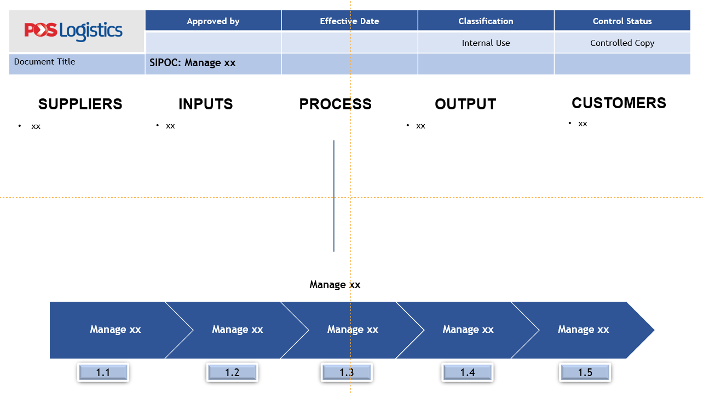
2
SIPOC
1. Start preparing a SIPOC diagram
C (Customers) : Who are your customers? (list both internal & external parties)
O (Output) : What do your customers want?
P (Process) : How do you deliver the output? (key processes involved in the value chain)
I (Input) : What are the material you need?
S (Supplier) : Who supply your material/ information?
Example

Slide 8
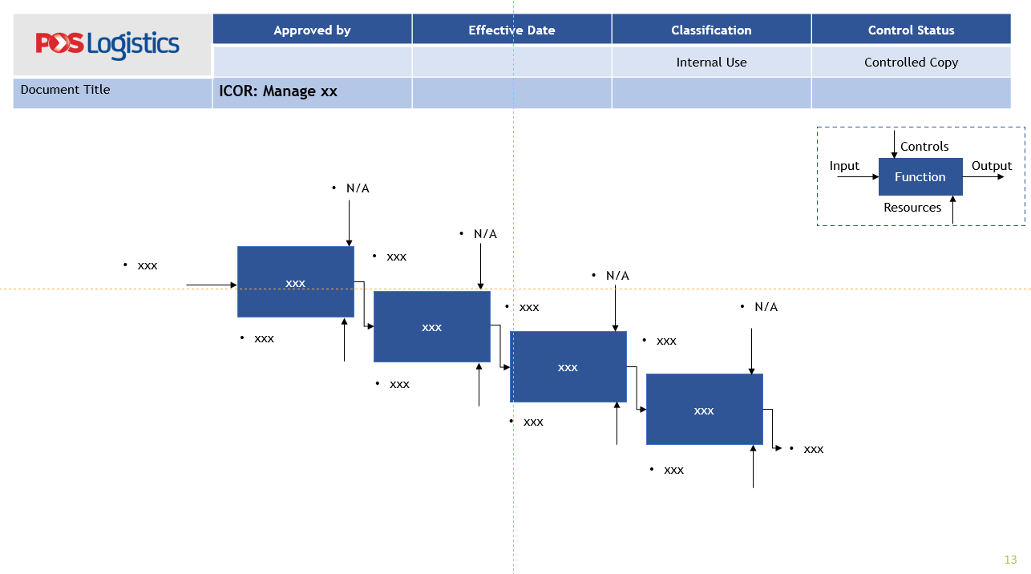
3
ICOR
1. Pick up one of the processes from the SIPOC and start identifying ICOR
2. Start preparing a ICOR diagram
I (Input) : What are material/information do you need?
C (Control) : What reference/documents do you use?
O (Output) : What are the outcome of what you do?
R (Resources)* : Who (people/system) responsible of doing the task?
Example
Function must be in verb e.g. review report draft
*People (position) involved refer to org chart, and enabler department

Slide 9
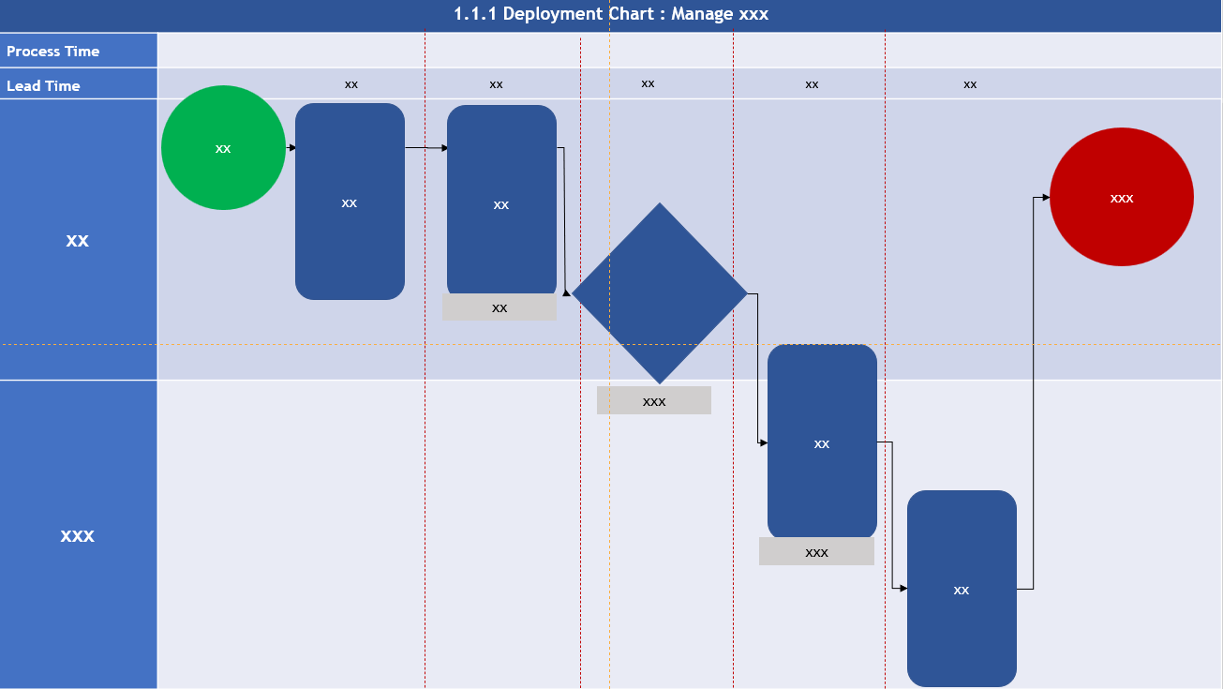
4
Deployment Chart
We are almost done!
Build deployment chart for each of the ICOR previously prepared to identify;
Who is doing what
When it is done
How long does it take to do what (time)
Example
Process time
Actual time spent working on a product or service.
Lead time
Total elapsed time from the start of a process to its completion that represent the total customer waiting time.

Slide 10


4 Levels of Mastery BandAna
Upon completion of this workshop, participants will achieve Level 1 (Yellow Band) competency in Business Process Mapping, which focuses on AI-enabled navigation and analysis of business processes.
Dark Blue
L4
Desired state Business Process Mapping + Manpower Optimization
Fuchsia
L3
Desired state Business Process Mapping + Process Optimization with AI assistance
Green
L2
Desired state Business Process Mapping + Process Improvement
Yellow
L1
Current state Business Process Mapping

Slide 11
THANK YOU!
Any questions?
Jasmiza Solutions Sdn Bhd.

